Slide 1
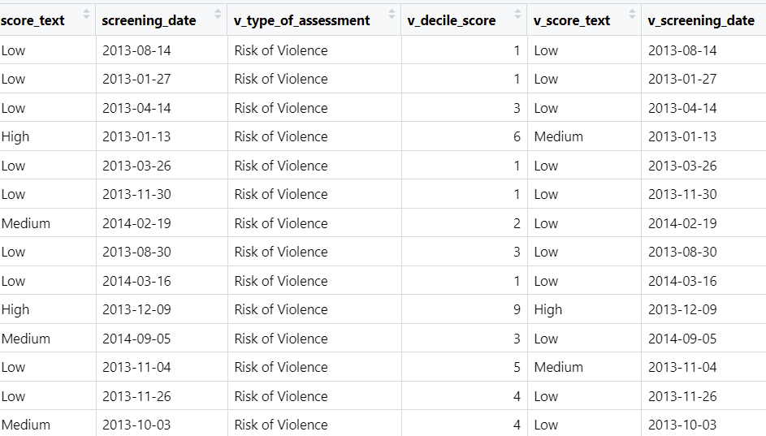

Slide 6
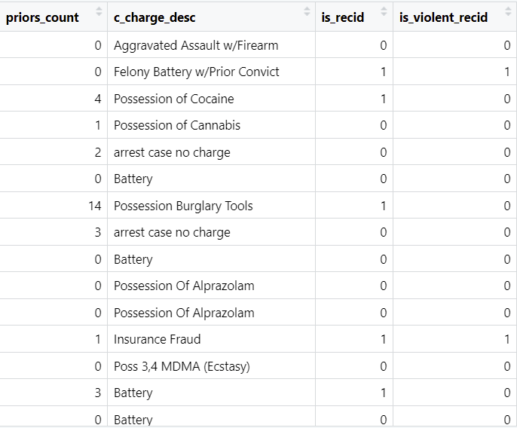

Slide 7
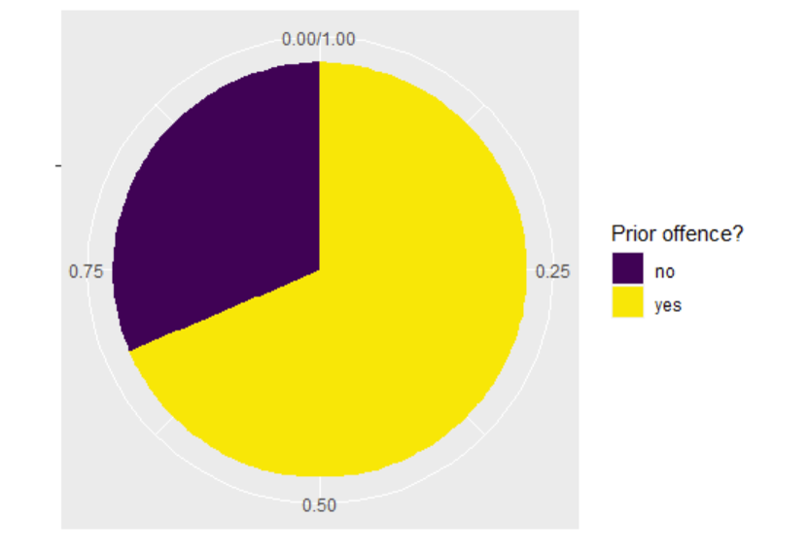
68.6% (7089/10331) of them had a prior offence

Slide 8
 | Count (%) who reoffended violently | Count (%) who reoffended
No prior offence | 166/3242 (5.1%) | 672/3242 (20.7%)
Prior offence | 653/7089 (9.2%) | 2801/7089 (39.5%)

Slide 9
 | Count (%) who reoffended violently | Count (%) who reoffended
No prior offence | 166/3242 (5.1%) | 672/3242 (20.7%)
Prior offence | 653/7089 (9.2%) | 2801/7089 (39.5%)

Slide 10
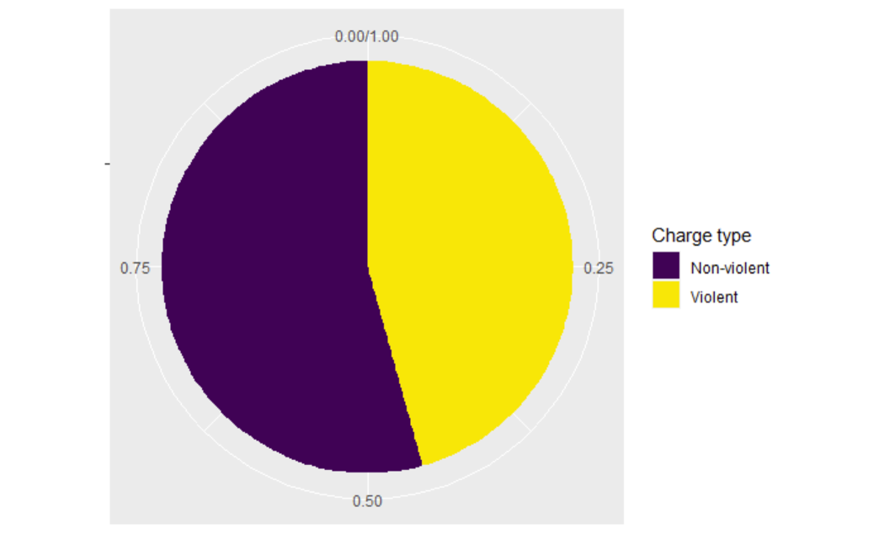
Of the charges the individuals faced, (4716/(4718+5613)) 45.7% were charged with a violent offence.

Slide 11
 | Count (%) who reoffended violently
Non-Violent charge | 406/5207 (7.2%)
Violent charge | 4123/4305 (8.8%)

Slide 12
Prior offence | Offence charge | Count (%) in data
No prior offence | Non-violent | 1260 (12.2%)
No prior offence | Violent | 1982 (19.2%)
Prior offence | Non-violent | 4353 (42.1%)
Prior offence | Violent | 2736 (26.5%)

Slide 13
Prior offence | Offence charge | Count (%) in data
No prior offence | Non-violent | 1260 (12.2%)
No prior offence | Violent | 1982 (19.2%)
Prior offence | Non-violent | 4353 (42.1%)
Prior offence | Violent | 2736 (26.5%)

Slide 14
Prior offence | Offence charge | Count (%) in data
No prior offence | Non-violent | 1260 (12.2%)
No prior offence | Violent | 1982 (19.2%)
Prior offence | Non-violent | 4353 (42.1%)
Prior offence | Violent | 2736 (26.5%)

Slide 15
Prior offence | Offence charge | Count (%) in data
No prior offence | Non-violent | 1260 (12.2%)
No prior offence | Violent | 1982 (19.2%)
Prior offence | Non-violent | 4353 (42.1%)
Prior offence | Violent | 2736 (26.5%)

Slide 16
Prior offence | Offence charge | Count (%) in data
No prior offence | Non-violent | 1260 (12.2%)
No prior offence | Violent | 1982 (19.2%)
Prior offence | Non-violent | 4353 (42.1%)
Prior offence | Violent | 2736 (26.5%)

Slide 17
Prior offence | Offence charge | Count (%) in data
No prior offence | Non-violent | 1260 (12.2%)
No prior offence | Violent | 1982 (19.2%)
Prior offence | Non-violent | 4353 (42.1%)
Prior offence | Violent | 2736 (26.5%)

Slide 18
Prior offence | Offence charge | Count (%) that reoffended violently
No prior offence | Non-violent | 63/1260 (5.0%)
No prior offence | Violent | 103/1982 (5.2%)
Prior offence | Non-violent | 343/4353 (7.9%)
Prior offence | Violent | 310/2736 (11.3%)

Slide 19
Prior offence | Offence charge | Count (%) that reoffended violently
No prior offence | Non-violent | 63/1260 (5.0%)
No prior offence | Violent | 103/1982 (5.2%)
Prior offence | Non-violent | 343/4353 (7.9%)
Prior offence | Violent | 310/2736 (11.3%)

Slide 20
Prior offence | Offence charge | Count (%) that reoffended violently
No prior offence | Non-violent | 63/1260 (5.0%)
No prior offence | Violent | 103/1982 (5.2%)
Prior offence | Non-violent | 343/4353 (7.9%)
Prior offence | Violent | 310/2736 (11.3%)

Slide 21
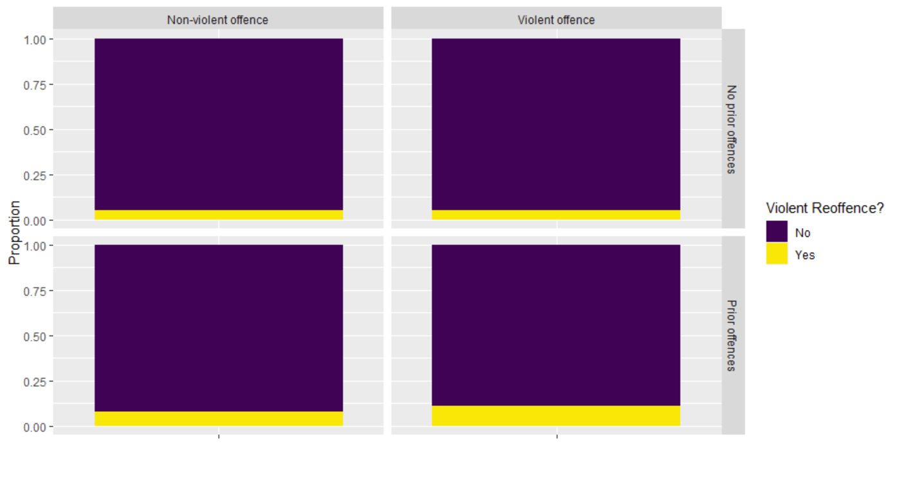
Prior offence | Offence charge | Count (%) that reoffended violently
No prior offence | Non-violent | 63/1260 (5.0%)
No prior offence | Violent | 103/1982 (5.2%)
Prior offence | Non-violent | 343/4353 (7.9%)
Prior offence | Violent | 310/2736 (11.3%)

Slide 22
Prior offence | Offence charge | Count (%) that reoffended violently
No prior offence | Non-violent | 63/1260 (5.0%)
No prior offence | Violent | 103/1982 (5.2%)
Prior offence | Non-violent | 343/4353 (7.9%)
Prior offence | Violent | 310/2736 (11.3%)

